Slide 1
Chapter 1:
Characterization of Distributed Systems

Slide 2
Assessments
Theory
  Quizzes/ Assignment 20%
  Midterm Exam 30%
  Final Exam 50%

Slide 3
Books
Text Book
  Distributed Systems : Concepts and Design
  By:
    George Coulouris, Jean Dollimore and Tim kindberg
    4th Edition
Reference
  Tanenbaum, Andrew S and van Steen, Maarten, Distributed Systems, Principles and Paradigms, Prentice Hall
Lab
  Different books

Slide 4
Course Outline
Characterization of distributed systems (chap 1)
System Models
Networking and Internet
Inter-process Communication
Distributed Objects and Remote Invocation
Operating system support
Security
Distributed File system
Name service
Peer to peer systems

Slide 5
Course Outline
Time and Global States
Coordination and agreement
Transaction and concurrency control
Distributed transactions
Replication
Mobile and Ubiquitous Computing
Distributed multimedia systems
Distributed shared memory
Web services

Slide 6
Distributed System
Definition
  A distributed system is a collection of independent computers that appears to its users as a single coherent system.
Two aspects
  Hardware
  Software
Characteristics of Distributed Systems
  Difference between the computers and the way they communicate with each other (hidden from the user).
  Users can interact with a distributed system in a consistent way regardless of where the interaction takes place.
To support the heterogeneity distributed systems are organized by means of a layer of software that is logically placed between high level layer and operating system layer. This layer is known as middleware.

Slide 7
Examples
Network of stations are there in a university department. Every user has its own workstation. But in addition there may be a pool of processors in the machine room that are not assigned to these users. But are allocated dynamically as needed. When user types a command the system could look for the best place to execute it. Either on the same workstation or somewhere else on the unassigned processors and at the end results are delivered back.
World Wide Web offers a simple, consistent and uniform model of distributed documents. To see a document user may activate a reference and document appears on the screen.

Slide 8
Introduction
A dist Sys is one in which components located at networked computers communicate & coordinate their actions only by passing messages.
This def. leads to the following characteristics of dist sys
  Concurrency of components
  Lack of a global clock
  Independent failures of components
Examples of dist sys are
  Internet
  Intranet (portion of internet managed by an org)
  Mobile & ubiquitous computing
Sharing of resources is the main motivation for constructing dist sys
  Managed by servers and accessed by clients
  Encapsulated as objects & accessed by other client objects
Challenge from the construction of dist sys are the heterogeneity of its components , openness, which allows components to be added or replaced, security, scalability, failure handling, concurrency of components & Transparency

Slide 9
Intro (cont.)
Networks of computers are everywhere. Internet (composed of many networks)
Mobile phone net, corporate net, factory net, campus net, home net, in-car net, all of these, both separately and in combination, share the essential characteristics that come under the distributed system.
Computers that are connected by a network may be spatially separated by any distance. They may be on separate continents, in the same building or in the same room.

Slide 10
Intro (Cont)
Concurrency:
  Concurrent execution is the normal thing in distributed systems.
  I do my work on my computer and you do your work on yours, sharing resources such as web pages or files when necessary.
  Capacity of the system to handle the shared resources can be increased by adding more resources to the network.
  The coordination of concurrently executing programs that share resources is also an important & recurring topic.

Slide 11
Intro (Cont)
Independent failures:
  All computers sys can fail & it’s the responsibility of sys designer to plan for the consequences of possible failures
  In dist sys, faults in the network result in the isolation of the computers that are connected to it, but that does not mean they stop running.
  Programs may not be able to detect whether the network has failed or has become unusually slow.
  Similarly an unexpected termination of a program somewhere in the sys is not immediately made known to other components with which it communicates
  Each component can fail independently, leaving the others still running.

Slide 12
Intro (Cont)
No global clock:
  To cooperate programs coordinate their actions by exchanging messages
  Close coordination often depends on a shared idea of the time
  There are limits to the accuracy with which networked computers can synchronize their clocks – there is no single global notion of the correct time
  This is a direct consequence of the fact that the only communication is by sending messages through a network.

Slide 13
Intro (Cont) - Resource
The motivation for constructing & using dist sys stems from a desire to share resources.
The term Resource is rather abstract one, but it best characterizes the range of things that can usefully be shared in a networked computer system.
  It extends from hardware components such as disks & printers to software-defined entities such as files, databases & data objects of all kinds.

Slide 14
Internet
A vast interconnection of computer networks of many diff types
Programs running on the computers interact by passing messages
A very large dist sys
The set of services is open-ended – it can be extended by the addition of server computers & new types of services
ISPs provide modem links & other types of connection to individuals and small organizations enabling them to access services anywhere in the internet.
A back bone is a network link with a high transmission capacity, employing satellite communications, fiber optics & other high bandwidth etc.
Multimedia services are available in the internet, enabling user to access audio & video data – limited facilities

Slide 15
A typical portion of the Internet
intranet

ISP



backbone
satellite link
desktop computer:
server:
network link:

Slide 16
Intranets
This is a portion of the Internet that is separately administered & has a boundary that can be configured to enforce local security policies
An intranet is connected to the internet via a router
The role of a firewall is to protect an intranet by preventing unauthorized messages leaving or entering
A firewall might for example allow only those messages related to email & web access to pass into or out of the intranet that it protects
Some organizations do not wish to connect their internal networks to the internet at all (some military org disconnect their internal networks from the internet at times of war)

Slide 17
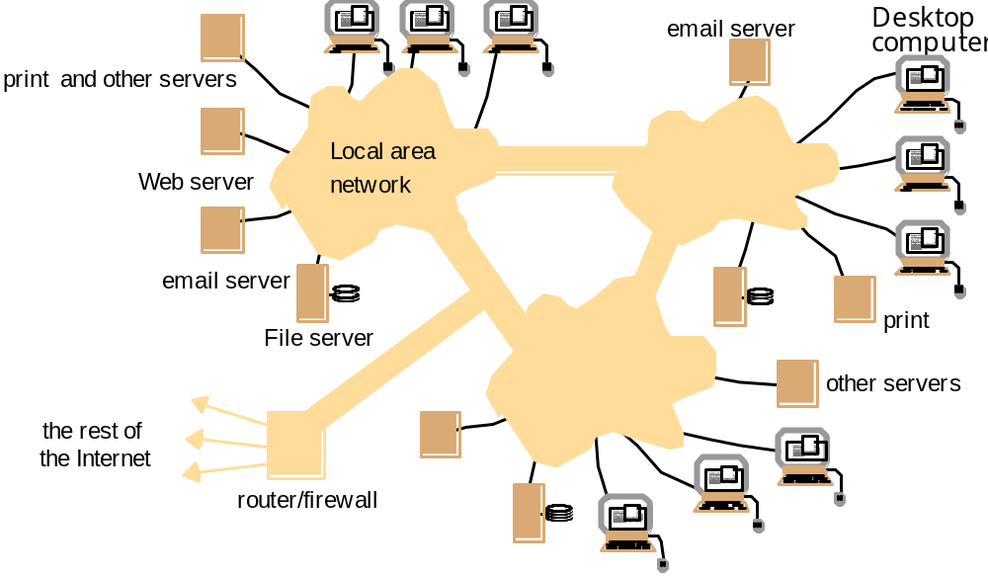
A typical intranet

Slide 18
Mobile & ubiquitous computing
Technology advances in device miniaturization & wireless networking have led increasingly to the integration of small & portable computing devices into dist sys. These devices include:
  Laptop computers
  Handheld devices, including personal digital assistants (PDAs), mobile phones, pagers, video cameras and digital cameras
  Devices embedded in appliances such as washing machines, hi-fi sys, cars & refrigerator
The portability of many of these devices, together with their ability to connect conveniently to networks in diff places, makes mobile computing possible.
Mobile computing is the performance of computing tasks while the user is on move or visiting places other than their usual env.
User who are away from their home intranet are still provided resources via the devices they carry with them
Provision to use to utilize resources such as printers that are conveniently nearby as they moved around (location-aware computing)

Slide 19
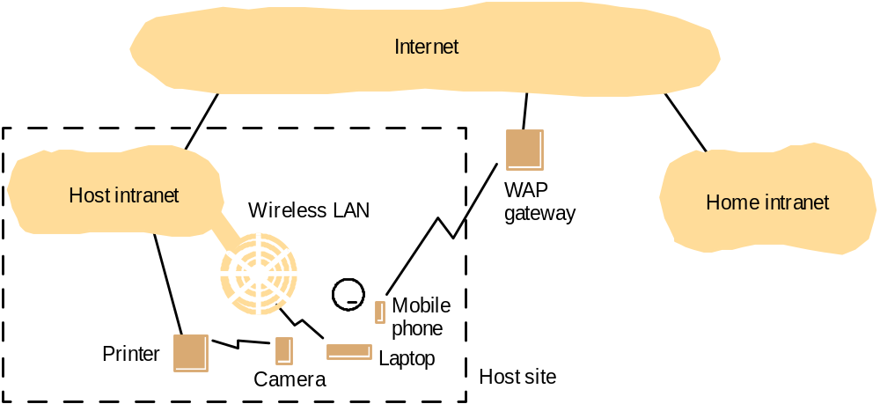
Portable and handheld devices in a distributed system

Slide 20
Mobile & ubiquitous computing (Cont)
Ubiquitous computing is the harnessing of many small, cheap computational devices that are present in user’s physical env.
  Could benefit users while they remain in a single env such as home or a hospital
  The presence of computers everywhere only becomes useful when they can communicate with one another.
Mobile & ubiquitous computing raise significant system issues:
  How to support the discovery of resources in the host env?
  Eliminating the need for users to reconfigure their mobile devices as they move around
  Helping users to cope with limited connectivity as they travel
  Providing privacy & other security guarantees to users & the env that they visit

Slide 21
Resource sharing
We routinely share hardware resources such as printers, data resources such as files and resources with more specific functionality such as search engines
Users are concerned with the sharing of high level resources such as shared database or a set of web pages.
The pattern of resource sharing vary widely.
Service: term used for a distinct part of a computer sys that manages a collection of related resources & presents their functionality to users
  Access shared files through file service
  Send documents to printers through printing service
The only access to the service is via set of operations that it exports.
  File service provides read, write & delete operations on files
Resources in dist sys are physically encapsulated within computers and can only be accessed from other computers by communication.

Slide 22
Resource sharing (Cont)
Server, client and message
A complete interaction between client & a server from the point when the client sends its request to when it receives the server’s response, is called remote invocation.
The terms ‘client’ & ‘server’ apply only to the roles played in a single request.
By default the terms ‘client’ & ‘server’ refer to processes rather than the computers that they execute upon.
  Servers run continuously
  Clients last as long as the application of they form a part
Many, but certainly not all, dist sys can be constructed entirely in the form of interacting clients & servers.
  The World Wide Web, email & networked printers all fit this model.

Slide 23
The World Wide Web
This is an evolving sys for publishing & accessing resources & services across the internet
The web began life at the European centre for nuclear research (CERN), Switzerland, in 1989 as a vehicle for exchanging documents between community of physicists connected by the internet.
Hypertext linked documents -- HTML
Require a browser to view documents of many types, listen audio and view video streams & interact with an unlimited set of services.
The web is open w.r.t. the types of ‘resource’ that can be published & shared on it.
  Browsers are designed to accommodate new content-presentation functionality in the form of ‘helper’ app and ‘plug-ins’
  Browser reads HTML tags and renders page on client screen
The web has moved beyond simple data resources to encompass services, such as electronic purchasing of goods. It has evolved without changing its basic architecture.

Slide 24
The World Wide Web (Cont)
The web is based on three main standard technological components.
  HTML: A lang for specifying the contents & layout of pages on the web
    Tags based mark up lang
  URL: To identify documents & other resources stored as part of web
    Scheme:scheme-specifi-location
  HTTP: Protocol by which browsers & other clients fetch documents

Slide 25
HTML
HTML (Hyper Text Markup Language) is a standard language used to develop web documents.Not completely standardized yet, not all versions of all browsers support all attributes
It uses tags to define certain directives. A tag is some directive or token enclosed in angle braces.
Hyper Text means text linked with some other document through a hyper link.
Markup means anything extra which is needed to present text. For example, to write a line of bold text, we write <B>Text</B>. These tags is markup.
An HTML document need not to compile. Its source is parsed and displayed by a web browser.
Parsing means that we identify the given tags and display the data given in the tags according to there predefined meanings.
Hyperlinks
<A HREF=http://cnn.com>Go to CNN</A> hyperlinks the specified text with the location mentioned in HREF attribute.
If you want to jump to a particular location within the displayed page then we define <A Name=“Tag”>Text to go</A> where we want to jump to. At FROM location, we write <A HREF=“#Tag”>GO</A>
<HTML>
<Head><Title>This is first page</title></head>
<Body><p>Hello World!
<img src=earth.jpg>
</body></html>

Slide 26
Uniform Resource Locator
The purpose of a Uniform Resource locator is to identify a resource in such a way as to enable the browser to locate that resource. Browsers examine the URL’S in order to fetch the corresponding resources from the web servers.
Sometimes users type a url otherwise browsers look up the corresponding url when the user clicks on a link e.g. an image.
Every URL has two top level components.
    Scheme:scheme-specifi-location
      First indicates which type of resource browser is going to deal with.
      Second indicates the location where the resource is present.
World wide web is open w.r.t type of resources.

Slide 27
Uniform Resource Locator (contd.)
HTTP URLS are the most widely used for fetching resources using the standard http protocol.
    http://servername[:port][/pathNameOnServer][?arguments]

Slide 28
URLS (Web servers and web browsers)
http://www.google.comlsearch?q=distibuted
www.google.com
Web servers
Browsers
www.cdk3.net
Internet
http://www.cdk3.net/
www.w3c.org
File system of
http://www.w3c.org/Protocols/Activity.html
www.w3c.org
Protocols
Activity.html
Web documents use the HTML representation instead of specifying a detailed document format, HTML allows a document to contain general guidelines for display, and allows a browser to choose details. Consequently, two browsers may display an HTML document differently

Slide 29
HTTP
Defines the ways in which the client and servers interact with each other to exchange information with each other. HTTP has different main features:
Request-reply interaction
Content types (MIME type: Multipurpose Internet Mail Extensions)
One resource per request (HTTP version 1.0)
Simple access control—password protected
Publishing a resource

Slide 30
Hypertext Transfer Protocol (http)
Request-reply interaction
  The Hyper Text Transfer Protocol (HTTP) is the client-server protocol that has been in use. Whenever you surf the web, your browser will be sending HTTP request messages for HTML pages to the server. Web servers handle these requests by returning response messages. HTTP is a request/response protocol. Client making an HTTP request is referred as user agent. The responding server is called the origin server.

Slide 31
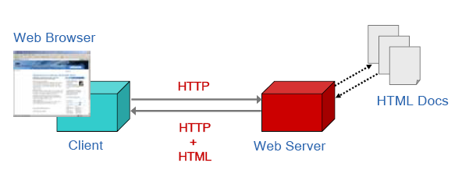
HTTP (cont’d)

Slide 32
HTTP (cont’d)
  Request message is sent to the server by the client.
  Server receives the request. Then it responds. If request is granted then along with the approval response message the contents of the webpage are also being sent.

Slide 33
HTTP (cont’d)
  One important thing is that client sends messages to the server not by using its IP address. But we always refer the webpage as follows:
  www.yahoo.com/carfinance.html
  Then is it converted to IP address at the back end?

Slide 34
The World Wide Web (Adv)
Static, Dynamic and Interactive web page
DHTML
  Dynamic HTML is not a standard defined by the World Wide Web Consortium (W3C), it is a "marketing term" that was used by Netscape and Microsoft to describe the new technologies the 4.x generation browsers would support.
  Dynamic HTML is a combination of technologies to make Web pages dynamic. To most people Dynamic HTML means a combination of HTML 4.0, Style Sheets and JavaScript
  HTML→ Contents
  CSS → Appearance
  Javascript → Interactivity
Send Request with Get and Post methods
Server (CGI or active pages) & Client side execution
Dangling links, lost in hyperspace
Users following confusingly many disparate links
  Search engines are a useful complement to link-following as a means of finding info on web-but imperfect at producing what the user specifically intends

Slide 35
XML
There is an increase need to exchange many types of structured data on the web – HTML is limited; only for information browsing
XML has been designed as a way of representing data in standard, structured, application-specific form
XML: a meta-lang for describing data
  XML stands for Extensible Markup Language
  XML is a markup language much like HTML
  XML was designed to describe data
  XML tags are not predefined in XML. You must define your own tags
  XML uses a Document Type Definition (DTD) or an XML Schema to describe the data
  XML with a DTD or XML Schema is designed to be self-descriptive
XML was designed to describe data and to focus on what data is.
HTML was designed to display data and to focus on how data looks.
HTML is about displaying information, while XML is about describing information
<message>
<to>Dave</to>
<from>Susan</from>
<subject>Reminder</subject>
<text>Buy milk on the way home.</text>
</message>

Slide 36
Web Problems
As a system architecture the web faces problems of scale. Popular web servers may experience many hits per second and as a result the response to users is slow
  The use of caching in browsers and proxy servers to alleviate these effects
The web client-server architecture means that it has no efficient means of keeping users up to date with the latest versions of pages.
  Browser reload buttons are to be clicked for latest information & browsers are forc4ed to communicate with servers to check whether a local copy of a resource is still valid.
A web page is not always a satisfactory user interface
  Applets, activeX components are used with an increase in the download time.

Slide 37
Challenges in Distributed System
DS provide us the sharing of resources. The development of distributed systems is a challenging task. There are number of issues or challenges which arise during the development of a distributed system. Most of the challenges have already been met however we must know about them.
  Heterogeneity
  Openness
  Security
  Scalability
  Failure Handling
  Concurrency
  Transparency

Slide 38
Heterogeneity
As we know that World Wide Web is a distributed system which allows the users to share different resources. The www (internet) users may access services over heterogeneous collection of computers and networks. The term heterogeneity applies to the following:
  Computers
  Network
  Operating Systems …..
Internet is composed of different networks. But the problem is solved by the fact that protocols are being used for the communication.
But problem may arise between the programs running on two different machines when messages are exchanged between them. e.g. integers may be represented differently on different computers.

Slide 39
Heterogeneity (contd.)
Internet protocols are responsible for the transmission of data between the two computers. But what when the data reaches within the computer. E.g. I had made a program in java on 1 PC. Now when program starts then it sends the request to other program made in C++ on PC 2. The problem will arise as Java uses different style for storing the integers.
Middleware: The term refers to a software layer that provides the abstraction thus masking the heterogeneity. CORBA is an example which will be discussed in the later chapters.
Mobile Code: Mobile code is the one that can be sent from one computer to the other. E.g. Java Applets.
Virtual Machine: Its allows the code to be executed on any particular machine. The compiler generates code for the virtual machine which in turn generates the code for the underlying hardware.

Slide 40
Openness
Openness of a computer system means that the computer system can be extended or not ? E.g. I have 1 GB ram in the computer. Can I extend it ? and so on. While openness of a distributed system mean the degree to which the new resource and services can be added and made available for use by a variety of client programs.
In distributed system on every system there are different programs or components which are running. In order to use these components we should be able to utilize their functionality. Every component has key interfaces via which we can use its functions and hence the functionality. So these interfaces must be published i.e. developers can use them.
Publishing is the only starting point. So that component or program can be updated but it will be difficult to update if different developers are working on the came component.

Slide 41
Openness (contd.)
So openness cannot be achieved unless the specification and documentation of these interfaces will be made available to the developers.
So there are two things:
  Publishing the interfaces of program/software.
  Integration of the services written by the different developers in different ways.

Slide 42
Security
DS maintain the information resources for the users. The security of such resources is important. When we talk about the security we talk about three things:
  Confidentiality Protection against disclosure to the unauthorized
  individuals.
  Integrity Protection against the alteration or corruption.
  Availability Genuine users should be given immediate access to the
  resource.
Firewalls
In a DS client may send request to server to perform a specific operation.
  Now server must check the identity of the individual. Then it must make sure that request had been made by the authentic individual.
  How we can solve this thing ?
    Encryption

Slide 43
Scalability
Ds is said to be scalable if it remains effective when there is a significant increase in the number of resources and number of users. Internet provides an illustration of the DS in which number of computers and services have increased dramatically as shown in Figures 1.5.
Figure 1.6 Computers in the Internet
Date
Computers
Web servers
1979, Dec.
188
0
1989, July
130,000
0
1999, July
56,218,000
5,560,866
2003, Jan.
171,638,297
35,424,956

Slide 44
Scalability (contd.)
We should focus on the following issues:
  Controlling the cost of physical resources
    As demand for resource grows we can extend the system via adding more resources at a reasonable cost. E.g. the frequency with which the files are accessed may increase with the increase in no of users. So we can purchase another file server to avoid the bottleneck and improve the performance.
  Controlling the performance loss
    Every resource or data is managed e.g. distributed databases. When we make a query then specific algorithm runs on the back end to find the data. Instead of linear we should use appropriate (hierarchically) Algorithms which work better in case of scalability.
  Preventing software's resources running out
    An example is IP addresses. So first 32 bits were used and now 128 bit has been provided. So in the future if this issue raised then other problem will arise and components will be required to be updated.

Slide 45
Scalability (contd.)
  Avoiding performance bottlenecks
    Decentralized algorithm should be used. E.g. DNS. Initially there was one DNS. But as number of users increase then DNS was distributed on different servers in order to improve the performance.
  Ideally system and application software do not change when the scale of the system increases. But this is very difficult to achieve.

Slide 46
Failure Handling
Failures may occur in different ways. Failures in a DS are partial i.e. some components may fail while others will keep on working. Following techniques can be used to detect the failures:
  Detecting Failures
  Tolerating failures
  Recovery from failure
  Redundancy

Slide 47
Concurrency
There is a possibility that multiple clients can use the same resource at the same time e.g. a data structure that records online bids may be accessed frequently when the deadline is near to end.
Process manages resource and it should allow multiple users to access it. E.g. resource is encapsulated as an object and that invocations are executed in concurrent threads. In this case several threads are executing concurrently with in an object and the operations should not conflict with each other and should provide the consistent results.
For an object to be safe in a concurrent environment its operations must be synchronized in such a way that its data remains contant.

Slide 48
Transparency
Transparency means that the concealment of different and separation of components from the users and application programmers. They will always perceive that there is a single system who is performing their requests.
  Access Transparency : Enables local and remote resources to be accessed using identical operations e.g. streams read write in same way.
  Location Transparency: Enable resources to be accessed without knowledge of their physical or network location e.g. URL’S is location transparent.
  Failure Transparency: Enables the concealment of faults e.g. retransmission etc.
  Mobility transparency: Allows the movement of resources and clients with in a system without affecting the operation of users. E.g. mobile phone. Both caller (client) and callee (resource) are traveling to different places.

